Slide 1
External Value
(Showcasing - Placebo Trust)
External value products do not necessarily need to demonstrate their effectiveness.
Internal value products necessarily need to demonstrate their effectiveness.
Factory
(Needs to get permits to operate)
Office Building Air Quality EU
(Regulatory)
Education
(Every school should have air purifier for Covid)
Hotels, Hospitals, Retail
(Establish trust among clients)
Low Price
High Price
Education PRIVATE
(Rich school wants to keep students safe from Covid.)
Office Building Air Quality APAC
(Improving productivity/Cutting down sick leave)
Internal Value
(Verifiable trust with change in outcome)

Slide 2
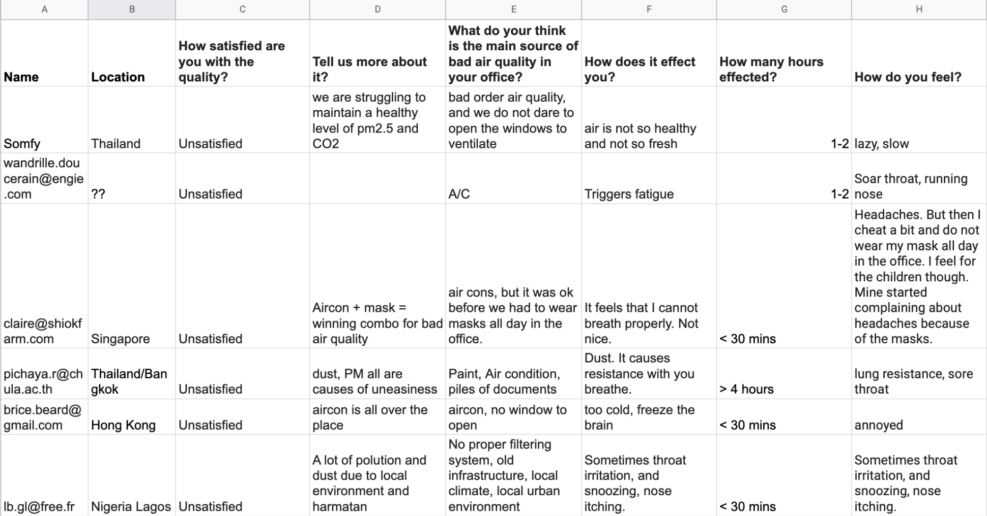

Slide 3
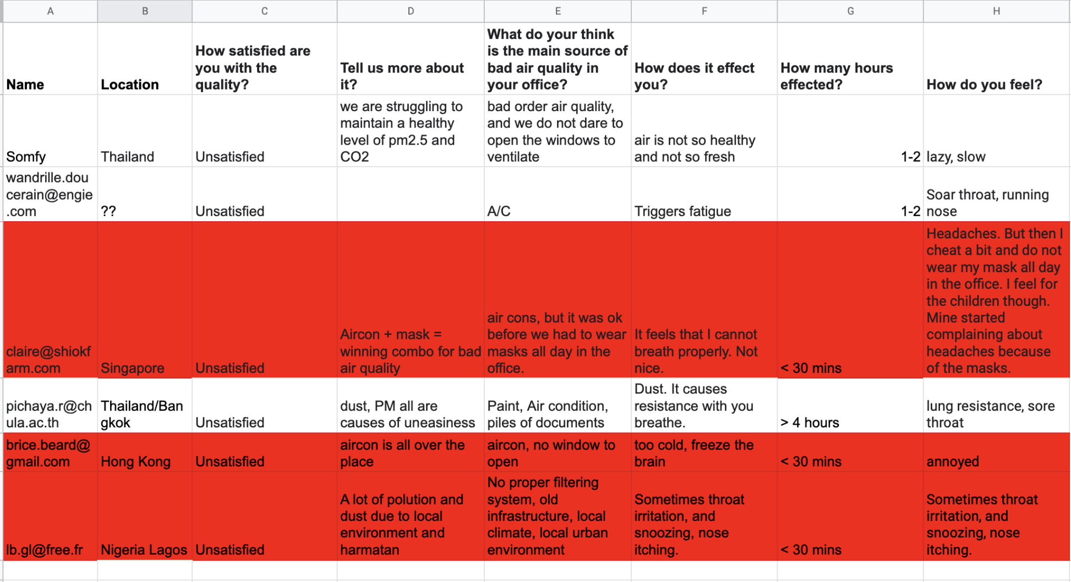

Slide 4
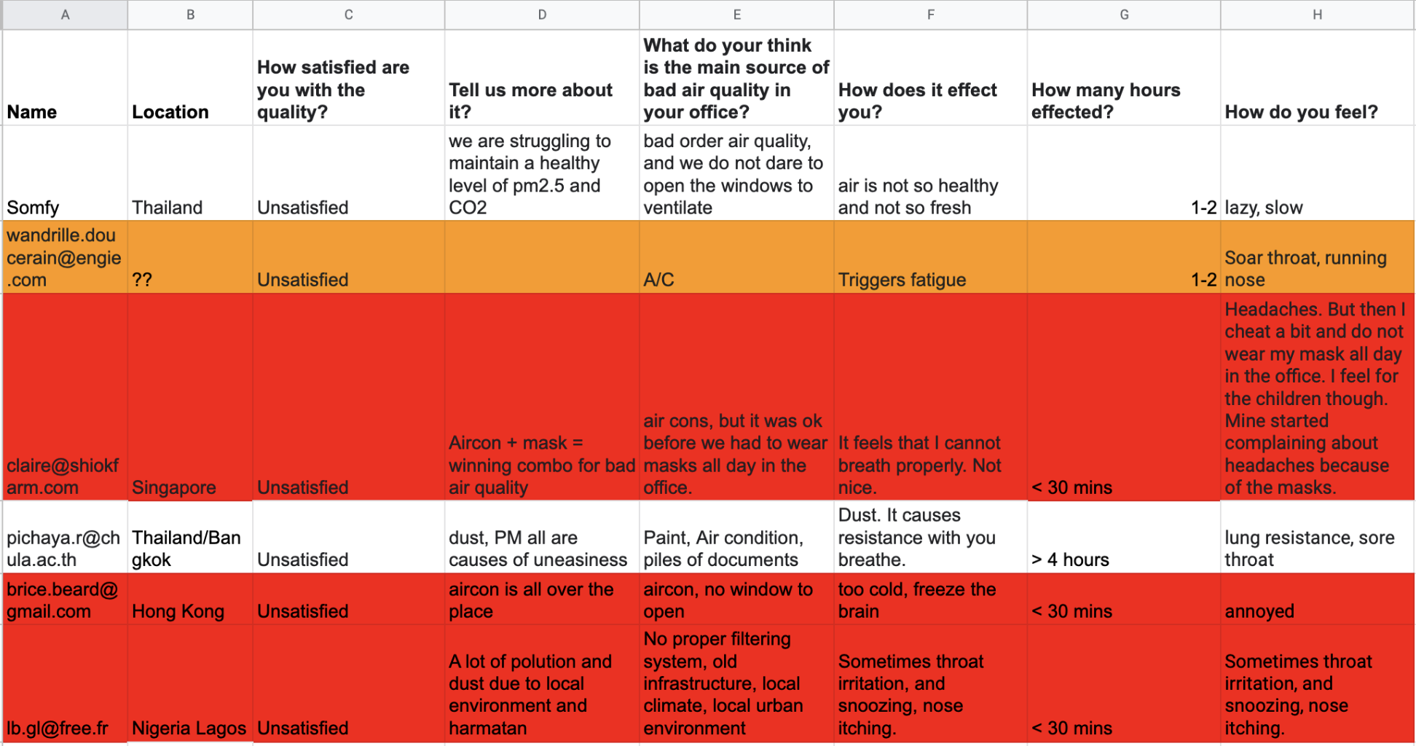

Slide 5
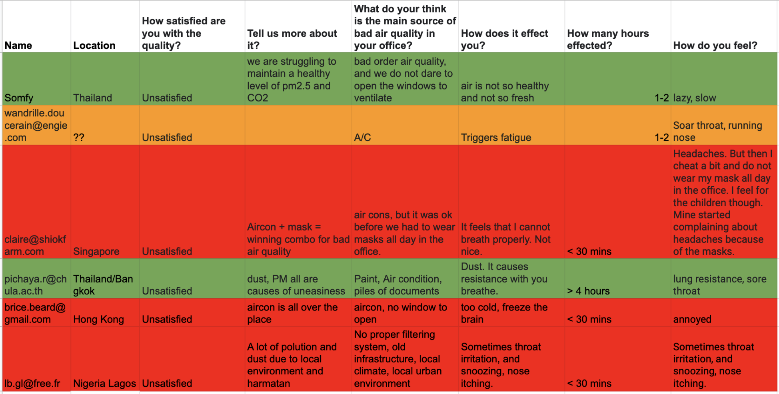

Slide 6
